Slide 1
Electric Vehicle ETL Project
We Got No Gas
Beth Gietl
Lori Fraunfelder
Ce’Aren Robinson
Rob Thompson
Lynn Pettis

Slide 2
01
Project Outline
02
Extract / Locating the Data Sources
Locating the original data sources (CSV & HTML)
03
Transform / Data Cleanup & Analysis
Cleaned and transformed the data for analysis.
04
Load / Final Dataset
CONTENTS
Join data sources into the final dataset with tables and collections.
05
Project Summary & Limitations

Slide 3
Project Outline:
We looked at two Electric Vehicle (EV) data sources.
Downloaded CSV file from Kaggle.com
Scraped an HTML article from CarAndDriver.com
We examined and compared the data from the two sources. The sources had similar data; make, model, range, etc.
They also carried unique values separately and through the ETL process we joined the two data sources together to enhance the analysis.

Slide 4
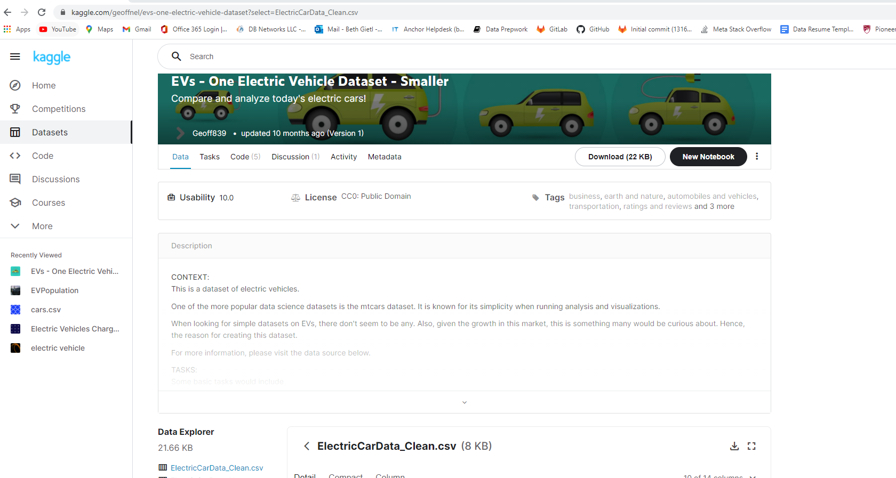

Extract: First Data Source, CSV file from Kaggle.com

Slide 5
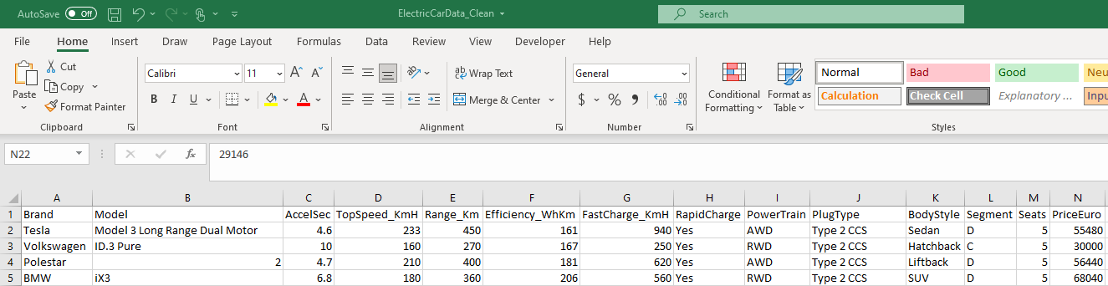
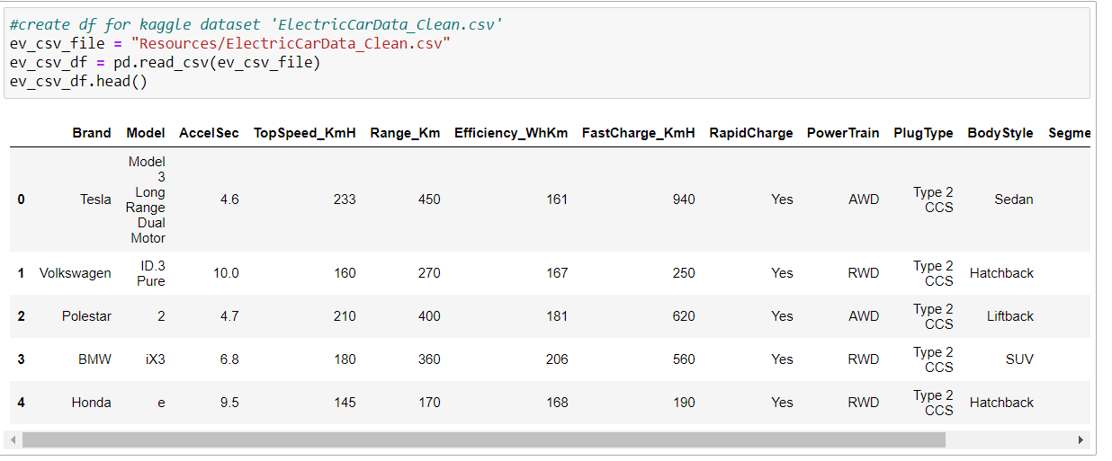
Extract: CSV file to a Pandas DataFrame
CSV
Pandas DataFrame

Slide 6
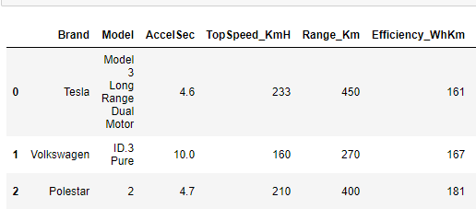
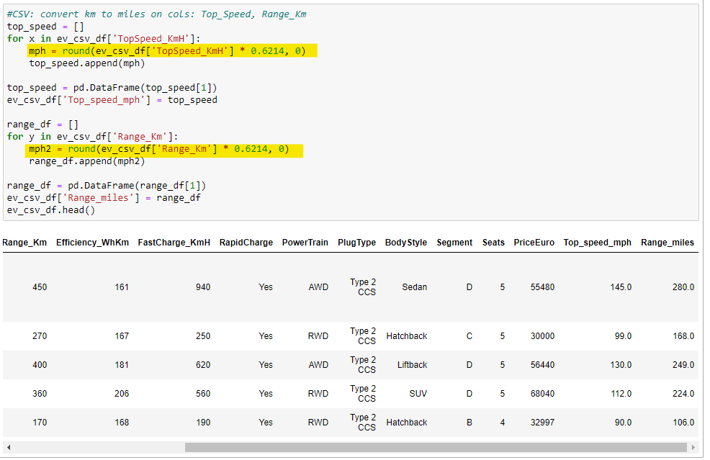
Transform: Clean the CSV DataFrame
Using Pandas we converted the Kilometers per hour in the Top Speed and Range columns to Miles per hour.

Slide 7
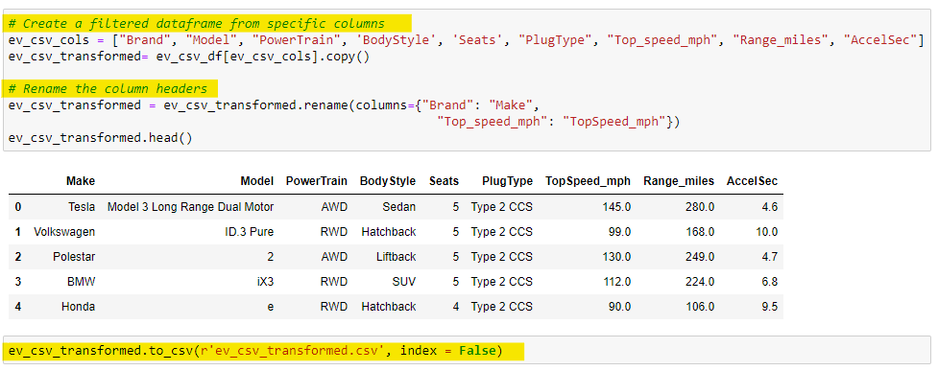
Transform: Clean the CSV DataFrame continued
Using Pandas we transformed the CSV DataFrame:
Created a filtered DataFrame and dropped unnecessary columns
Renamed column headers
Read and Saved the DataFrame to a new CSV file

Slide 8
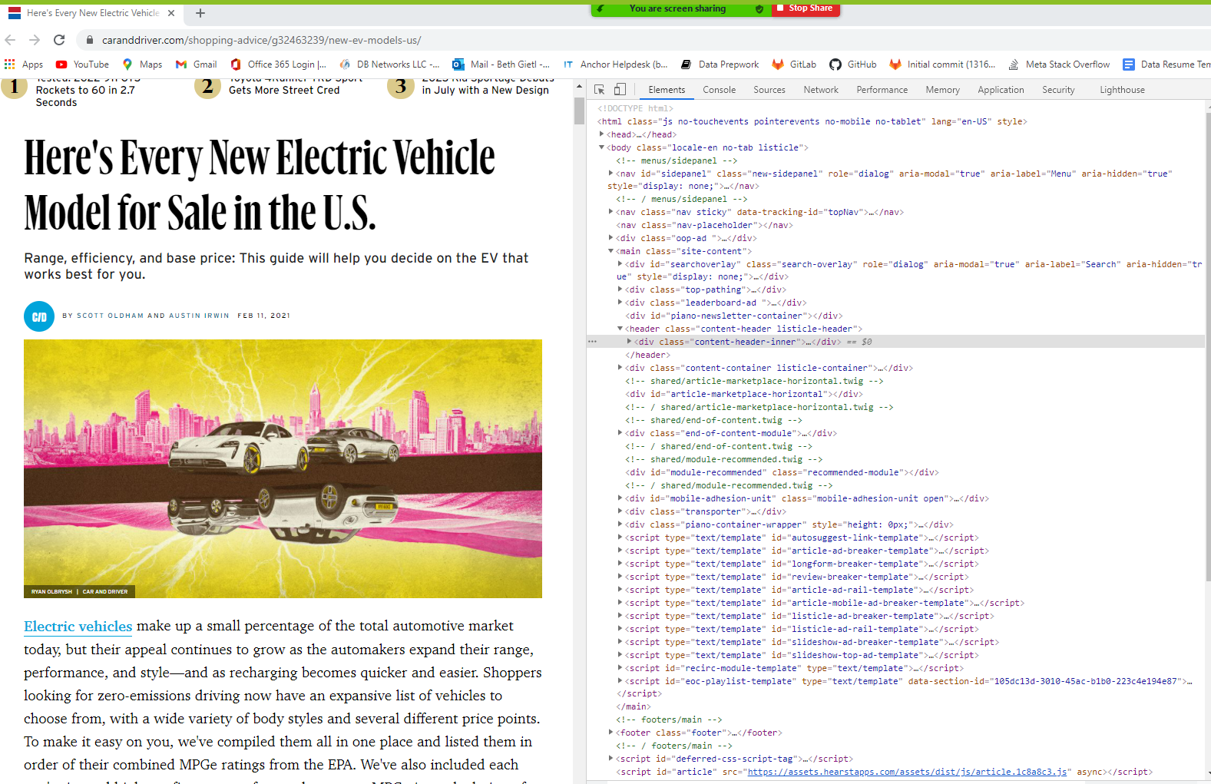
Extract: Second Data Source, HTML Article from CarAndDriver.com

Slide 9
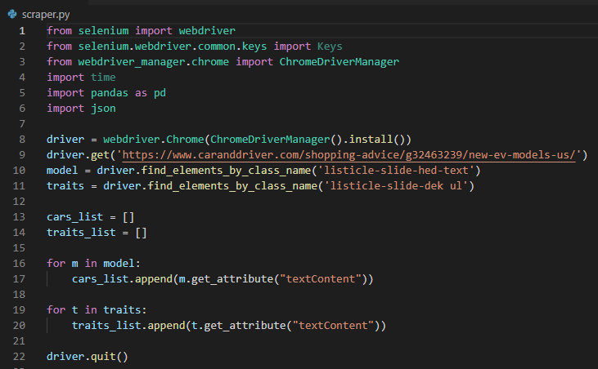


Extract: HTML to Pandas
Scraped the HTML to Pandas
Created driver variable to access the webpage
Directed the driver variable to obtain the data we were looking for
Created the for loops to assign the data to open lists
Good lesson learned was QUIT THE DRIVER!

Slide 10
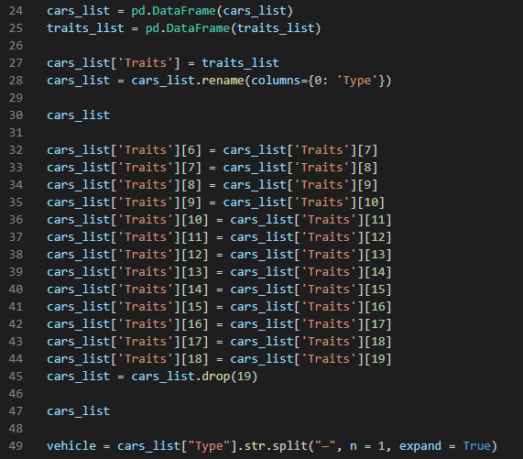
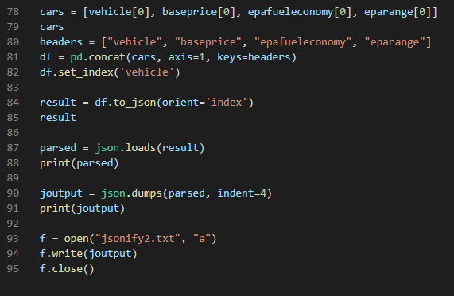

Transform: Pandas to JSON
Pandas to JSON:
5. Created Pandas DataFrames from the lists
6. Merged the DataFrames to one DataFrame
There were two columns in the Combined DataFrame
“Types”
“Traits” which contained a string of data
During the conversion there were Null values inserted in the cars_list DataFrame and the “Traits” values shifted down one row. Re- numbered the “Traits” with the correct “Type”
Split the string of data in the “Traits” column into component pieces. Split at the dash, colon, and space to extract the necessary data for our transformed DataFrame. Repeated split process for base price, fuel economy, and range
Created a DataFrame composed of the ex- tracted values from the code above
Process of JSONIFY the DataFrame
This Photo by Unknown Author is licensed under CC BY-NC

Slide 11
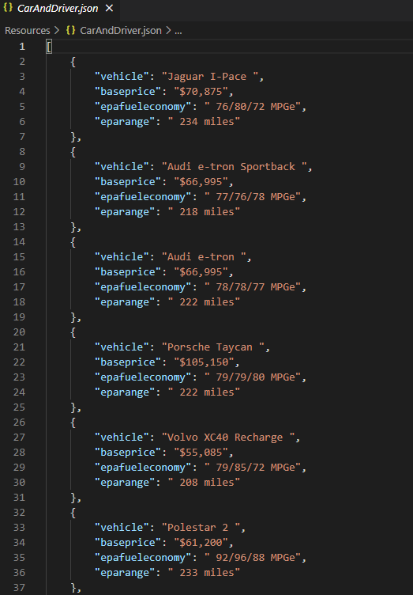
Transform: Pandas to JSON - Output

Slide 12
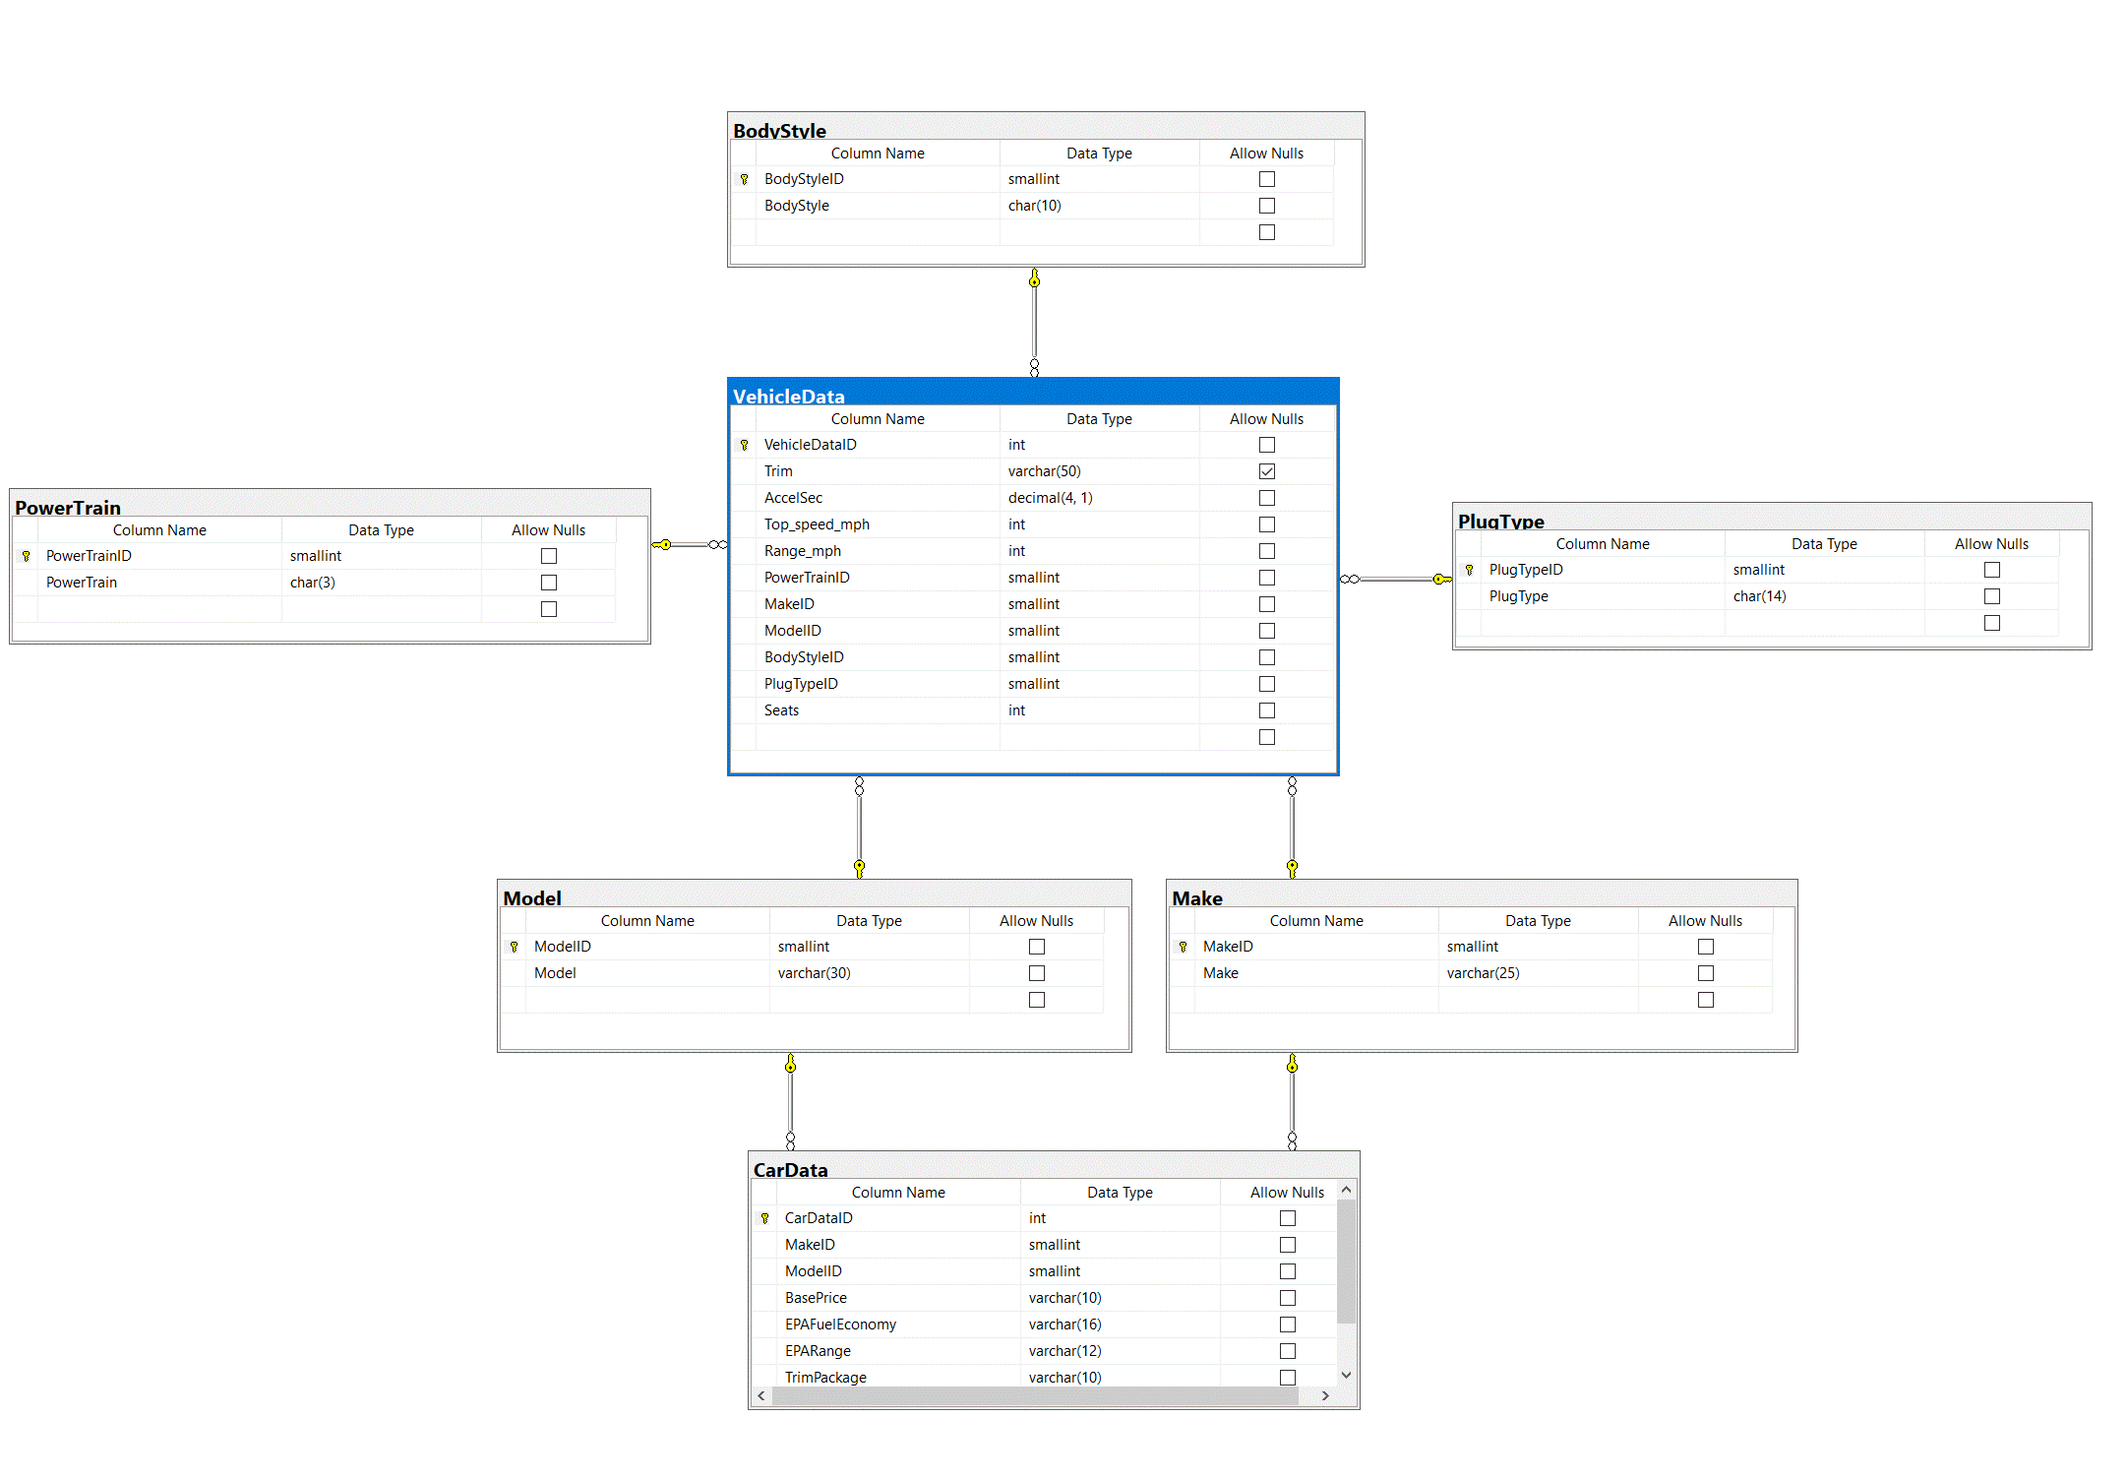
Load: Entity Relationship Diagram (ERD)
Our ERD provides a visual method of modeling the data.
We used Microsoft SQL Server Management Studio to write the code, create the tables and assign primary keys and create the foreign keys.

Slide 13
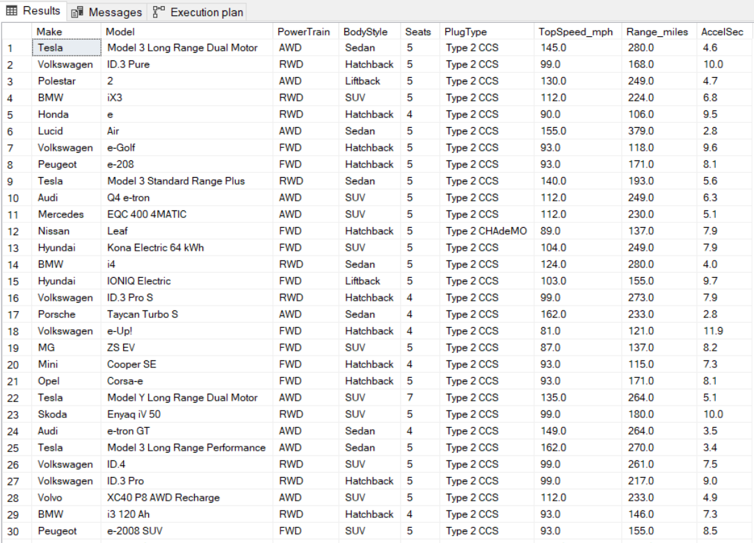
Load: CSV to Staging Table

Slide 14
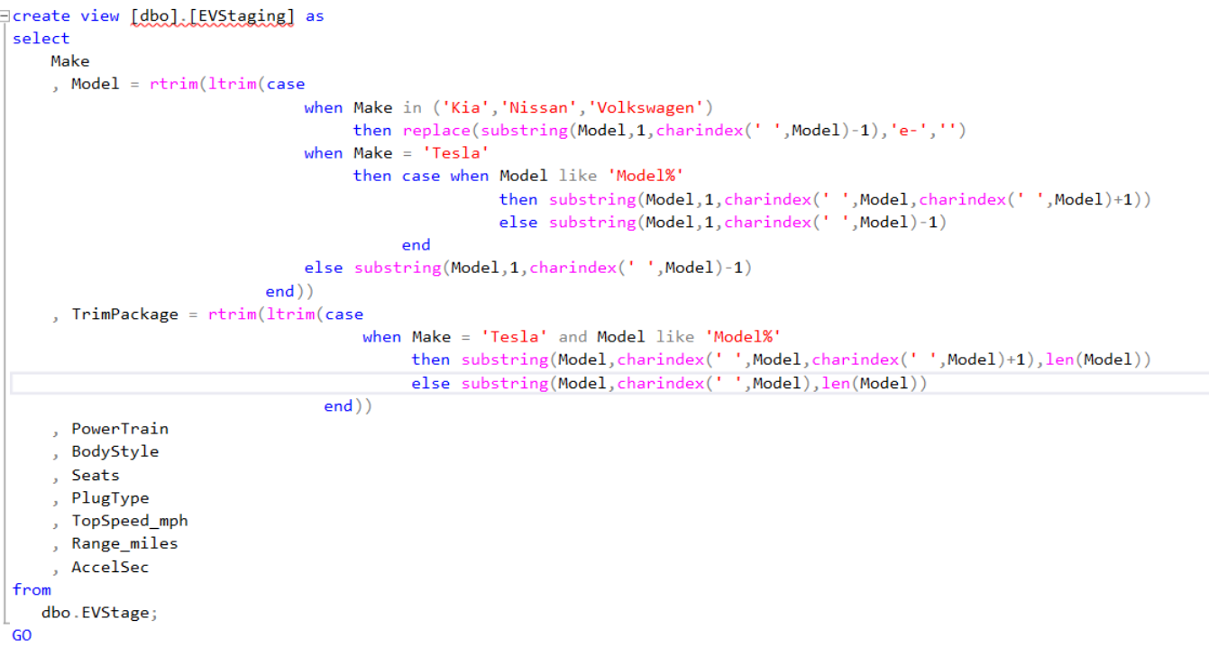
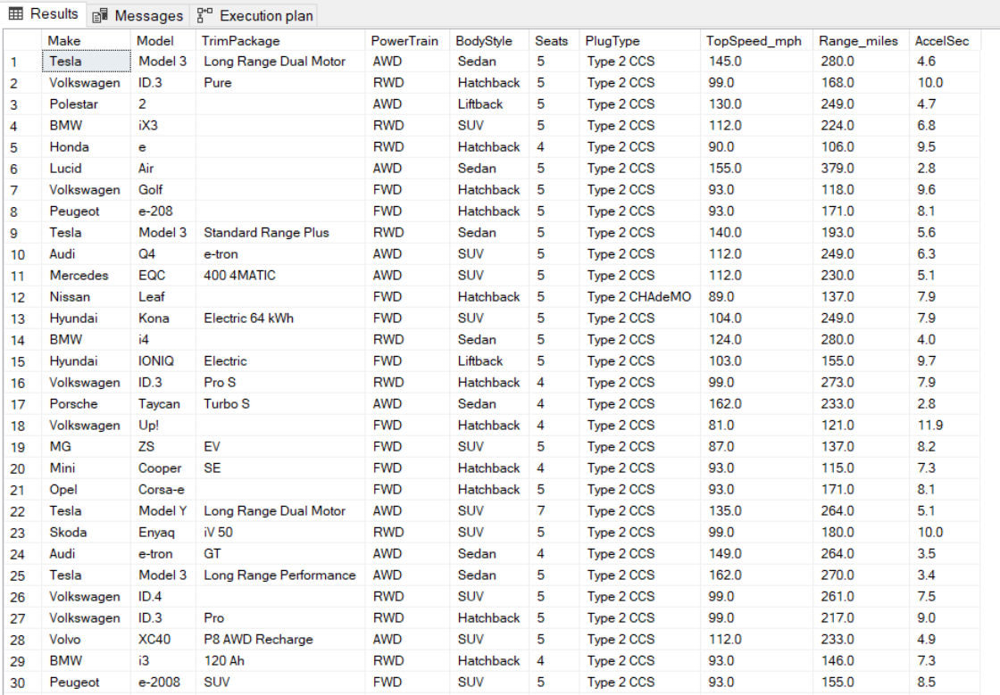
Load: CSV Data Normalization and Cleaning
Created a View to manipulate the data and split off the trim package from the model. The purpose was to align the data from the JSON file with the data in the CSV file.
Dropped unnecessary characters (“e-”) from the model of certain makes.

Slide 15
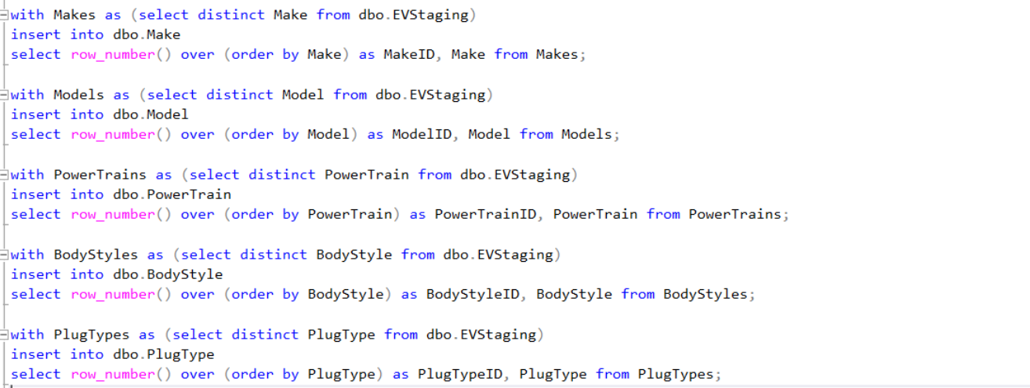
Load: Lookup Tables
Using CTEs (Common Table Expressions) to pull the distinct Make, Model, PowerTrain, BodyStyle, and PlugType information from the file to store in the lookup tables.
The Row_Number function is used to generate the ID values to be used in the tables.

Slide 16
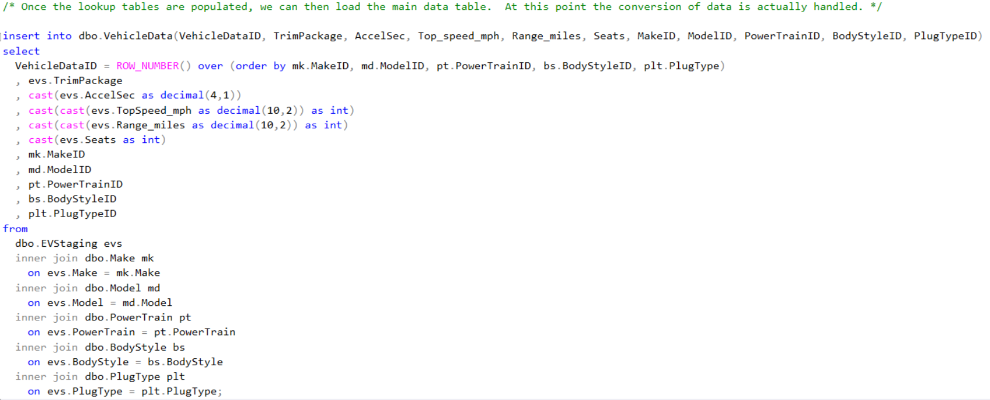
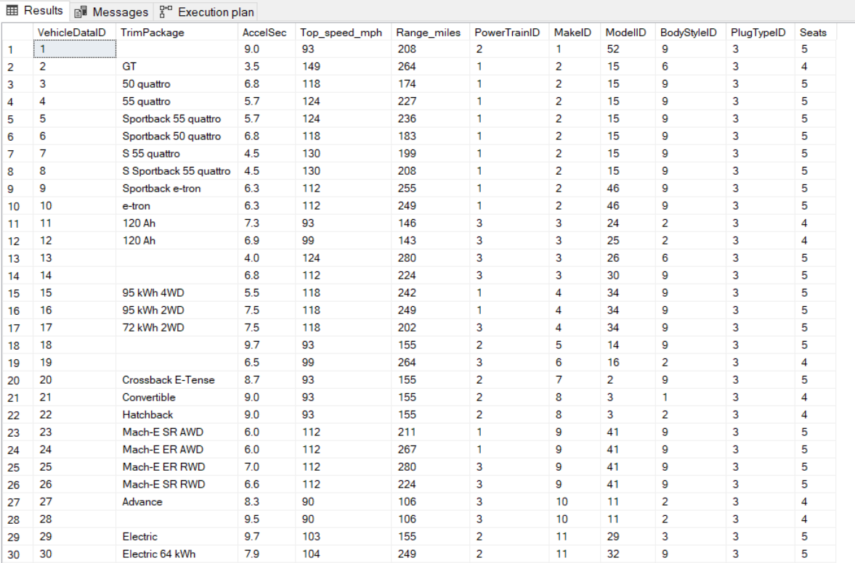
Load: Loading the data
Once the lookup tables were populated, we loaded the main data table.

Slide 17
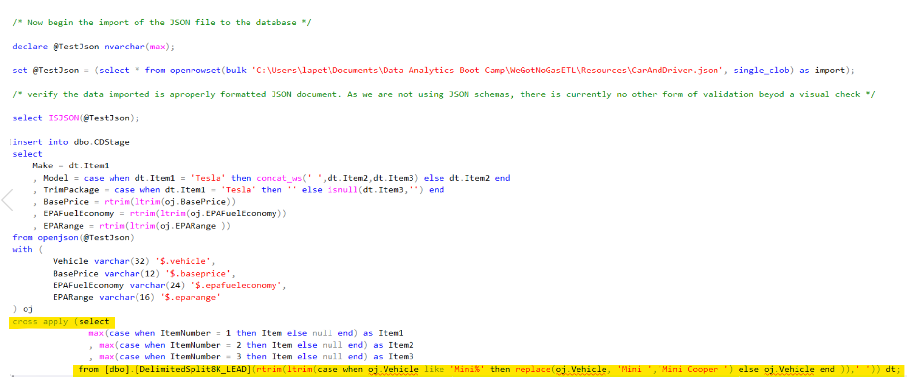
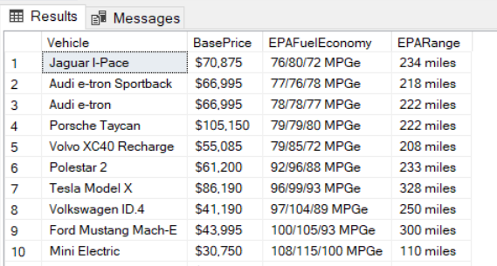
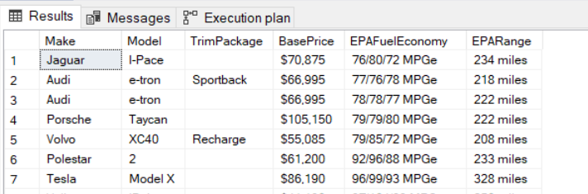
Load: JSON to Staging Table, Data Normalization / Clean
Imported the JSON File
Parsed the data as part of the staging process
Pivoted the data to a single row
Delimited split to split out the Make, Model and Trim Package.

Slide 18
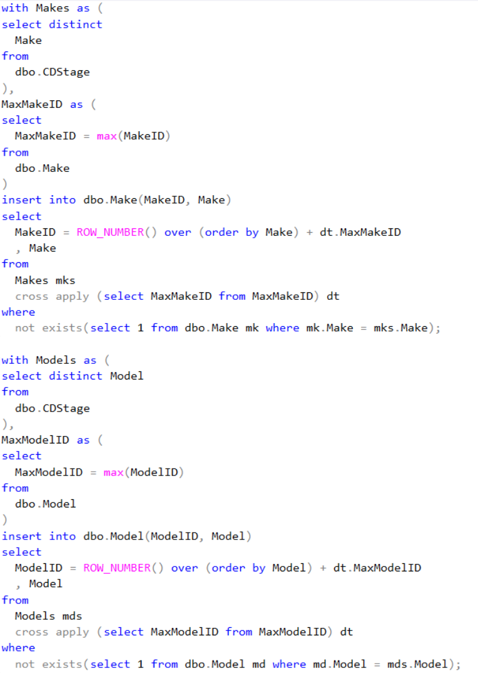
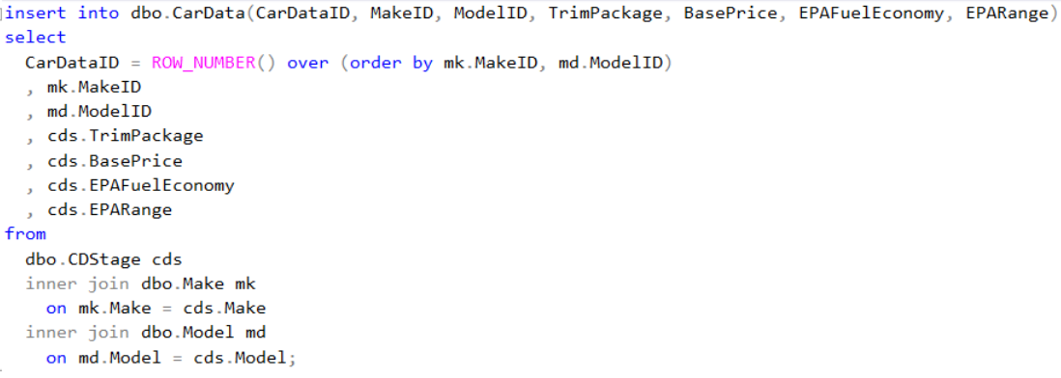
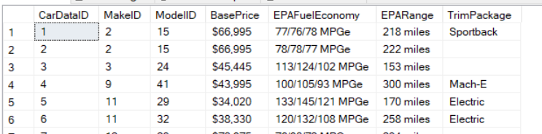
Load: Loading new data
First, inserted new data (“Make” & “Model”) that existed in the staged JSON table but not in the CSV staged table.
Second, loaded the data

Slide 19
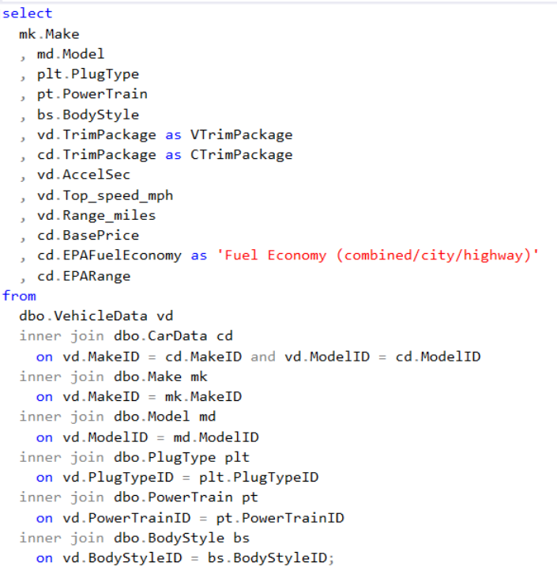
Joined the VehicleData table (CSV), the CarData table (JSON) and the Lookup Tables to create the Dataset
Load: Join Tables

Slide 20
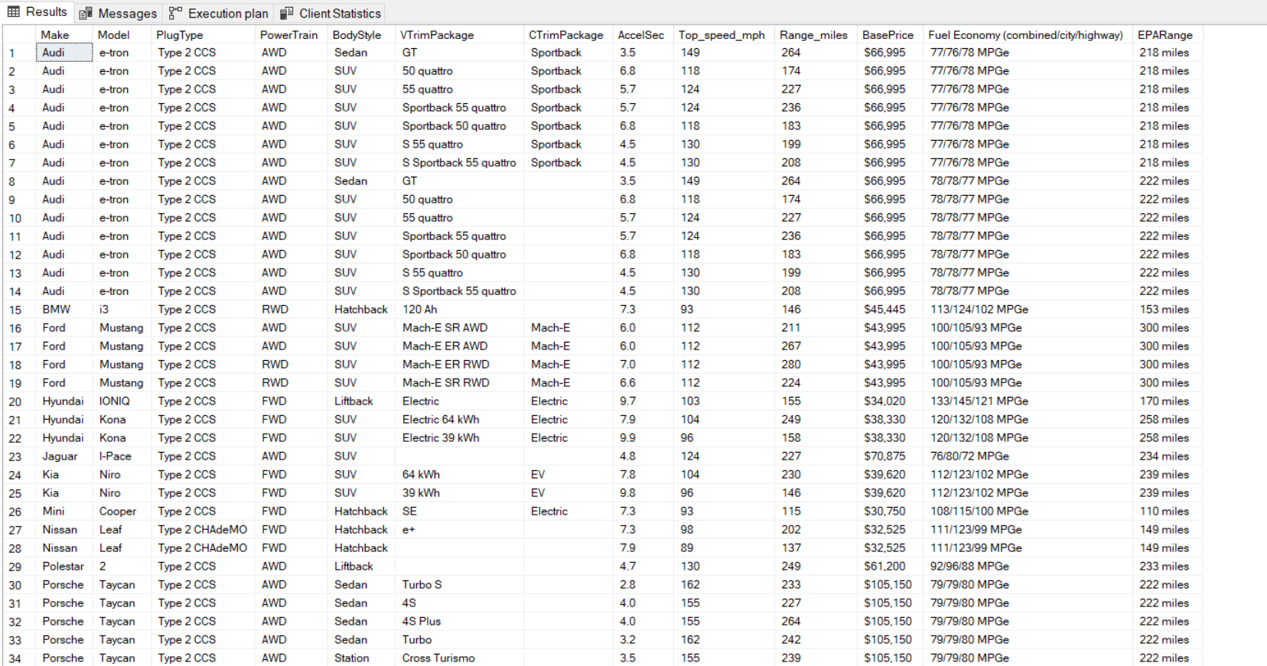
Final Dataset

Slide 21
Project Summary & Limitations
ETL Project Summary
Extract
We found two different data sources a CSV file and an HTML webpage.
Transform
We used Pandas and SQL to transform the data.
Load
We used Microsoft SQL Server to load and normalize the data further and join the tables to create a working dataset.
Project Limitations
For efficiency we used Microsoft SQL Server instead of the class recommendation PostgreSQL.
Timing for the assignment with team members on vacation during a holiday weekend.
More time would have allowed us to explore richer datasets.

Slide 22
THANK YOU

Slide 23
Sources
https://www.kaggle.com/geoffnel/evs-one-electric-vehicle-dataset?select=ElectricCarData_Clean.csv
https://www.caranddriver.com/shopping-advice/g32463239/new-ev-models-us/

